Slide 1

CONVOLUTIONAL ENCODER
&
TAIL-BITING VITERBI DECODER
(AWGN CHANNEL)
Venkat
Vidyadhar
Vikas

Slide 2
‘WHY’ TAIL-BITING ???
In case of a Viterbi decoder we append zeroes (called as the tail) to flush the bits in the encoder. Due to this addition of zeroes ,the bandwidth required for transmission increases.
In order to make efficient use of the bandwidth, we go for TAIL-BITING VITERBI DECODER.

Slide 3
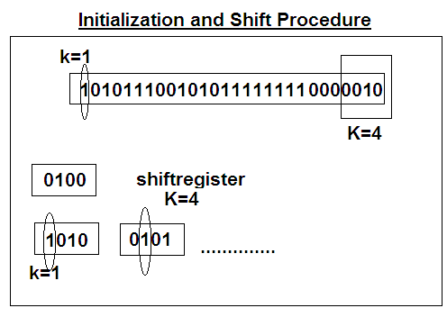
Convolutional Encoder
The final ‘K’ bits of the input are used to initialize the shift register initially.
Here on it is Conventionally Encoded

Slide 4
Transmission Over AWGN Channel
Given a uniform random variable U, a Rayleigh random variable R can be obtained by:
Where σ² is the variance of the Raleigh random variable, and given R and a second uniform random variable V, two Gaussian random variables G and H can be obtained by
G = R cos V and H = R sin V
In the AWGN channel, the signal is corrupted by additive noise, n(t), which has the power spectrum No/2 watts/Hz. The variance σ² of this noise is equal to N₀/2. If we set the energy per symbol Es equal to 1,
then . So .

Slide 5
Implementation Algorithm:
Step 1: Input Rate of Encoder (k, n)
Step 2: Input Constraint Length K
Step 3: Input the Packet size of the Channel (multiple of n)
Step 4: Input the Number of Frames to transmit over the Channel (nof)
Step 5: Encode (Encode the input and Transmit the Packet over the
channel)
Step 6: Add Noise (Channel adds this)
Step 7: Construct the State Transition Table.
Step 8: Decode (Decode the Received Packet)
Step 9: Repeat Step 5 through 7, nof times
Step 10: Calculate the Bit Error Rate comparing the input and output file.
Step 11: Stop

Slide 6
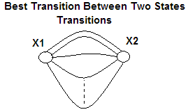
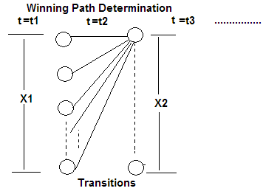
Tail Biting Viterbi Decoder
Time instant t, previous node x1 and present node x2
Data Structure used to represent the nodes in the Trellis
struct staten { int prev; int value; int input; float accum; };
The case of Multiple transitions
from particular x1 to x2 leads
to the calculation of Best Transition
among the various transitions
from particular x1 to x2 using Euclidean
Distance.
The case of determining the Winning
Path at x2 from various x1s to x2 is
by considering the minimum Euclidean
Distance.
Using the Data Structure we back track from the final state (tail) to the starting state (tail).

Slide 7
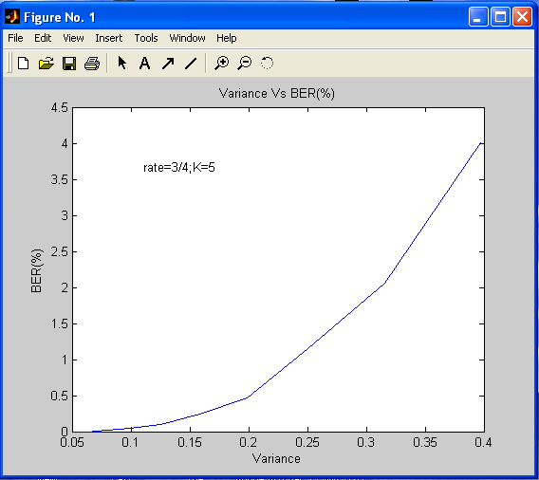
Observations:
Variance Vs BER(%) Plot
Polynomials considered are:
    1 0 0 0 0
    1 0 0 0 1
    1 1 0 0 0
    1 0 1 0 0

Slide 8
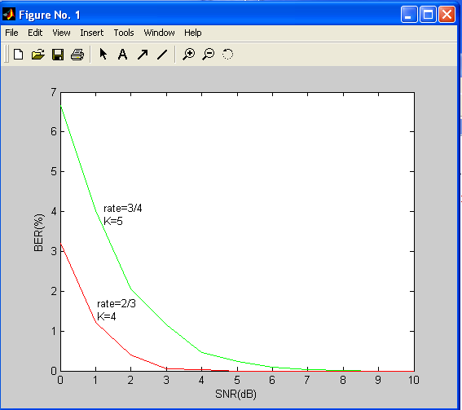
SNR(dB) Vs BER(%) Plot

Slide 9
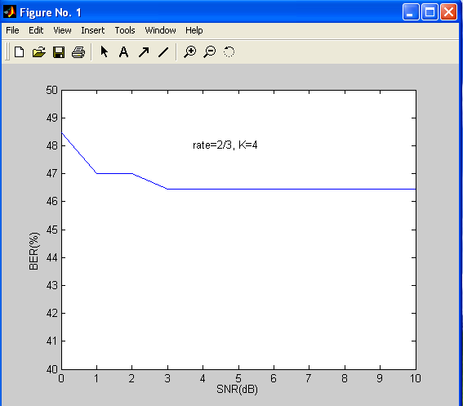
SNR Vs BER(%) Plot
(Catastrophic Polynomial)

Slide 10
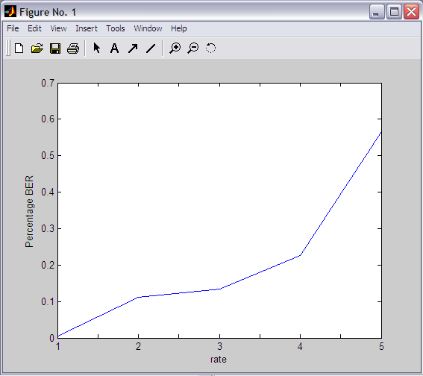
Rate Vs BER(%) Plot
On x axis
  1 => k=1, n=2, K=5 (10000, 01000) Packet Length=10000*10
  2 => k=2, n=3, K=5 (10000, 01100, 10100) Packet Length=9999*10
  3 => k=3, n=4, K=5 (10000, 01000, 00100, 00010) Packet Length=10000*10
  4 => k=4, n=5, K=5 (10000, 11100, 10101, 01010, 00011)
Packet Length=10000*10
  5 => k=5, n=6, K=7 (1000000, 0110011, 1100110, 0011001, 1010101, 0101010)
Packet Length=12000*10

Slide 11
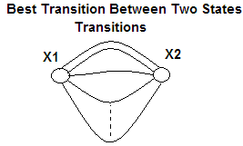
Tracing Out the Reasons for Errors in
Decoding (Inference)
Case 1: Best Transition (x1 to x2) Selection Ambiguity.
K-k is small- 2^{K-k} Number of states between which transition takes place is small.
2^{k} inputs- which leads to multiple transitions
between any two states. So, Increase in constraint
length increases K-k keeping k constant.
Then less will be the probability of error due to
multiple transitions (polynomial factor).
  k=2, n=3, K=3 (100,101,110) BER=0.150038%.
  k=2, n=3, K=4 (100,101,110,001) BER=0.09%
  k=3, n=4, K=4 (1000,1010,0101,1011) BER=0.33%
  ……………………
Case 2: Winning Path Selection Ambiguity. (Due to Noise Addition)
Case 3: Role of Polynomials.
Case …….

Slide 12
Transmission of 1MB File and SNR
FOR SNR of 6dB
k=1,n=2,K=3
Energy per Symbol =1
Polynomials: (100,101)
Packet Length: 2000000
Number of packets Sent: 1
Bit Error Rate: 0.00000%
FOR SNR of 4dB
k=1,n=2,K=3
Energy per Symbol =1
Polynomials: (100,101)
Packet Length: 2000000
Number of packets Sent: 1
Bit Error Rate: 0.006900%
FOR SNR of 2dB
k=1,n=2,K=3
Energy per Symbol =1
Polynomials: (100,101)
Packet Length: 2000000
Number of packets Sent: 1
Bit Error Rate: 0.16634%
FOR SNR of 6dB
k=1,n=2,K=3
Energy per Symbol =1
Polynomials: (100,101)
Packet Length: 200000
Number of packets Sent: 10
Bit Error Rate: 0.00000%
FOR SNR of 4dB
k=1,n=2,K=3
Energy per Symbol =1
Polynomials: (100,101)
Packet Length: 200000
Number of packets Sent: 10
Bit Error Rate: 0.007800%
FOR SNR of 2dB
k=1,n=2,K=3
Energy per Symbol =1
Polynomials: (100,101)
Packet Length: 200000
Number of packets Sent: 10
Bit Error Rate: 0.154600%

Slide 13
References:
Tail Biting Trellises of Block Codes- IEICE TRANS FUNDAMENTALS VOL.E 82-A
XILINX Documentation.
Digital Communication systems – Proakis
Communication Systems – Simon Haykins
www.complextoreal.com Tutorial 12
Editor Charan Langton

Slide 14
...????
Thank You
Project Associates:
        Venkata Thippanna Rao. P. R (145)
        Vidyadhar. N (147)
        Vikas. C (148)

